Slide 1
Hashing

Slide 2
Content
Hashing Definition
Hashing Methods
Amortized Analysis
Separate Chaining
Open Addressing

Slide 3
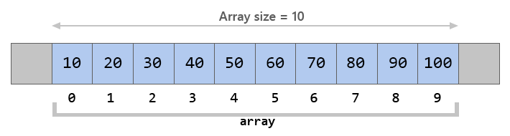
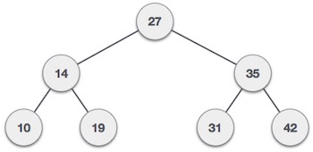
Let’s recall that the time complexity in order to search for an element in a list is O(n)
And in the binary search tree it’s O(logn)
IIs it possible to achieve a less time complexity when searching?

Slide 4
Hashing
Hashing is an important Data Structure which is designed to use a special function called the Hash function which is used to map a given value with a particular key for faster access of elements. The efficiency of mapping depends of the efficiency of the hash function used.
Best Case O(1)
Average Case O(1)
Worst Case O(n)

Slide 5
Direct Hashing
In direct hashing the key is the address without any algorithmic manipulation.
h(K) = K
0
1
4
7
8
9
Key Space
1
4
7
9
0
8
30

Slide 6
Advantages:-
- Searching O(1)
Insertion O(1)
Deletion O(1)
Disadvantage:-
Memory Consuming
Address Space (Array) should be as large as our key value which is inefficient

Slide 7
Division Method
h(k) = k mod n
Here, h(k) is the hash value obtained by dividing the key value k by size of hash table n using the remainder. It is best that n is a prime number as that makes sure the keys are distributed with more uniformity
Key Space
1
4
7
9
0
8
35
30
0 30
1
4
35
7
8
9
Collision

Slide 8
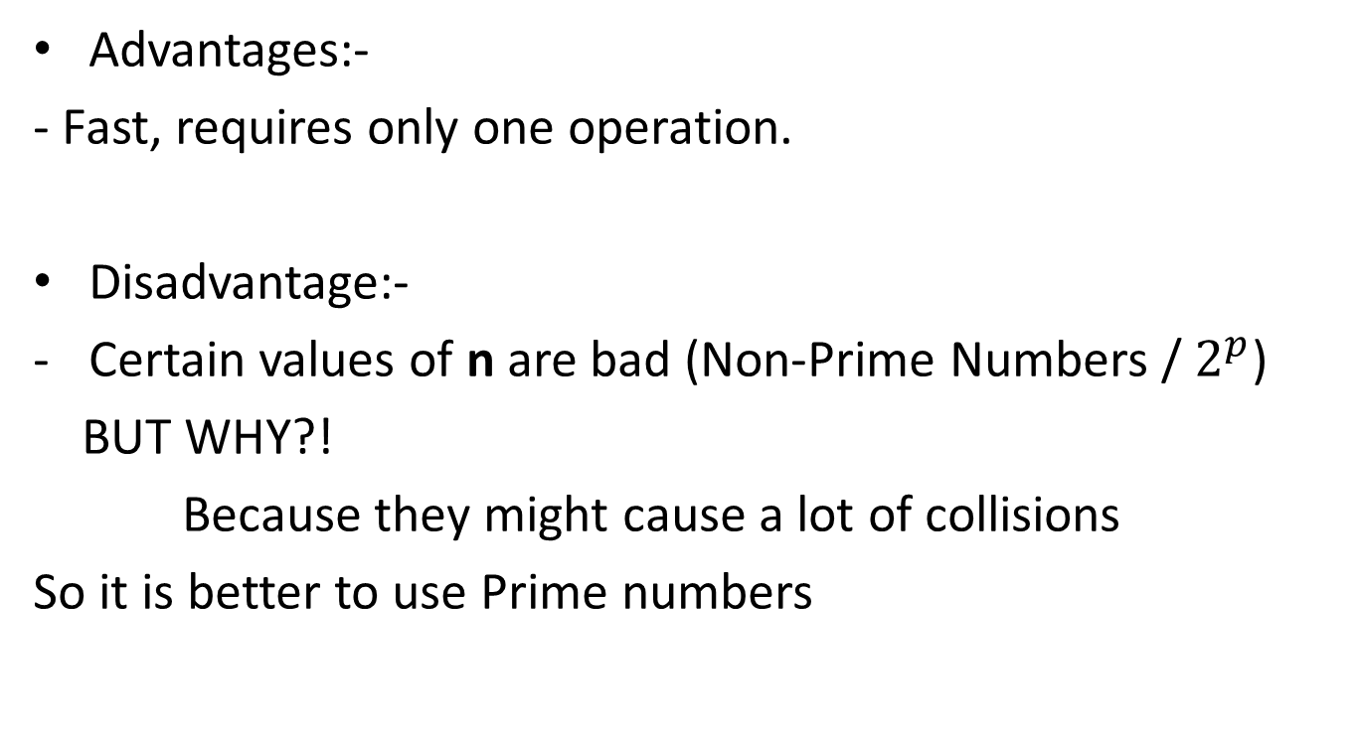
Advantages:-
- Fast, requires only one operation.
Disadvantage:-
Certain values of n are bad (Non-Prime Numbers / $2^{p}$)
BUT WHY?!
Because they might cause a lot of collisions
So it is better to use Prime numbers

Slide 9
If data is random then it doesn’t matter you can pick any size.
But when data is not random then strange things happen.
For Example:- If we use mod 4 we find:
10 mod 4 = 2
20 mod 4 = 0
30 mod 4 = 2
40 mod 4 = 0
50 mod 4 = 2
So from the 3 possible values of the modulus (0,1,2,3) only 0 and 2 will have collisions, that is bad.
If we use a prime number like 7:
10 mod 7 = 3
20 mod 7 = 6
30 mod 7 = 2
40 mod 7 = 4
50 mod 7 = 1

Slide 10
Multiplication Method
h(k) = floor( n( kA mod 1 ) )
Here, k is the key and A can be any constant value between 0 and 1
Both k and A are multiplied and their fractional part is separated. This is then multiplied with n to get the hash value.
Advantage: Value of n is not critical.
Disadvantage: Slower than division method

Slide 11
Example
k=123 n=100 A=0.618033
h(123) = 100 (123 * 0.618033 mod 1) =
100 (76.018059 mod 1) = ⌊ 100 (0.018059)⌋ = 1
k=150 n=100 A=0.618033
h(150) = 100 (150 * 0.618033 mod 1) =
100 (92.70495 mod 1) = ⌊ 100 (0.70495) ⌋ = 70

Slide 12
Mid Square Method
The mid square method is a very good hash function. It involves squaring the value of the key and then extracting the middle r digits as the hash value. The value of (r) can be decided according to the size (n) of the hash table.
Ex:- n= 10 → r= 1 bit
n= 100 → r= 2 bits
n= 1000 → r= 3 bits
Advantage: Collisions are much more less
Disadvantage: Difficult to calculate square of large values

Slide 13
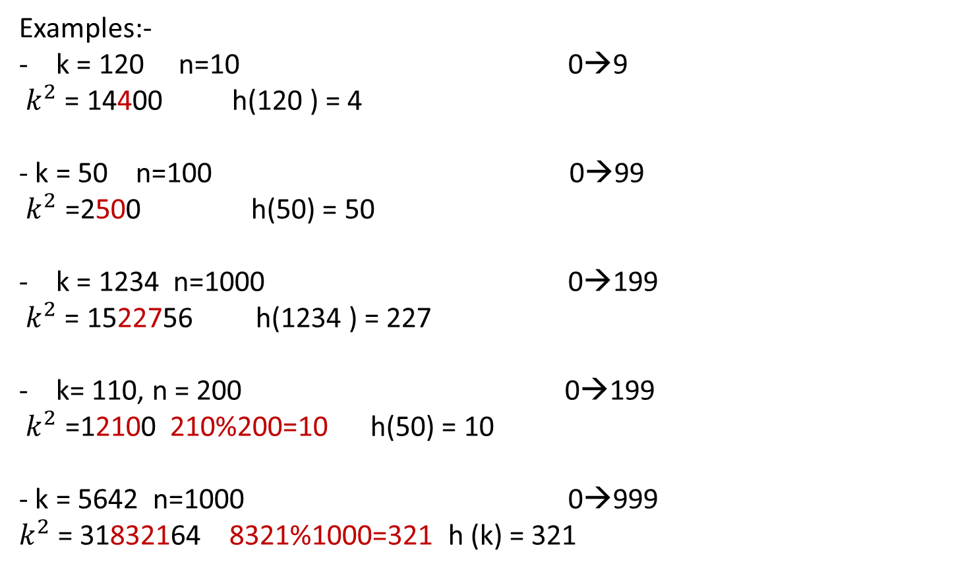
Examples:-
k = 120 n=10 0→9
$k^{2}$= 14400 h(120 ) = 4
- k = 50 n=100 0→99
$k^{2}$ =2500 h(50) = 50
k = 1234 n=1000 0→199
$k^{2}$= 1522756 h(1234 ) = 227
k= 110, n = 200 0→199
$k^{2}$ =12100 210%200=10 h(50) = 10
- k = 5642 n=1000 0→999
$k^{2}$= 31832164 8321%1000=321 h (k) = 321

Slide 14
Folding Method
Partition the key K into number of parts, like K1,K2,.....Kn, then add the parts together.
Notice that the partition depends on the address size
- If we have the key 12345678 and the address space is 3
Then we will divide our key into 123,456,78
- If the address space is 4
Then we will divide our key into 1234,5678

Slide 15
Fold‐shifting: Here actual values of each parts of key are added.
Suppose, the key is : 12345678, and the required address is of two digits (0→99)
Then break the key into: 12, 34, 56, 78.
Add these, we get 12 + 34 + 56 + 78 : 180
180 % 100 = 80
We get 80 as location
Fold‐boundary: Here we reverse the values of the outer parts and then we add the numbers.
Suppose, the key is : 12345678, and the required address is of two digits (0→99)
Then break the key into: 21, 34, 56, 87.
Add these, we get 21 + 34 + 56 + 87 : 198,
198 % 100 = 98
We get 98 as location

Slide 16
Amortized Analysis
Amortized Analysis is used for algorithms where an occasional operation is very slow, but most of the other operations are faster. In Amortized Analysis, we analyze a sequence of operations and guarantee a worst case average time which is lower than the worst case time of a particular expensive operation. The data structure shouldn't be labeled a costly structure just because that one operation, that is seldom performed, is costly.
Three common amortization arguments:
1) The aggregate method
2) The accounting method
3) The potential method.

Slide 17
Aggregate Method
The aggregate method is used to find the total cost. If we want to add a bunch of data, then we need to find the amortized cost by this formula.

Slide 18
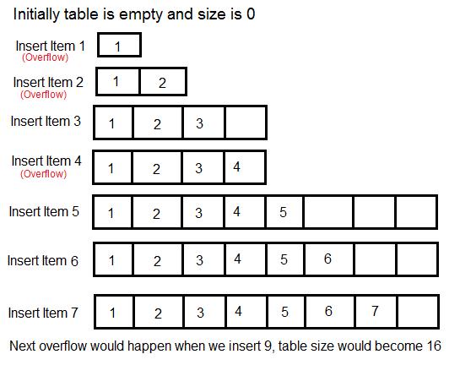
Let us consider an example of a simple hash table insertions. How do we decide table size? There is a trade-off between space and time, if we make hash-table size big, search time becomes fast, but space required becomes high.
The solution to this trade-off problem is to use Dynamic Arrays.
The idea is to increase size of table whenever it becomes full. Following are the steps to follow when table becomes full. 1) Allocate memory for a larger table of size, typically twice the old table. 2) Copy the contents of old table to new table. 3) Free the old table.
If the table has space available, we simply insert new item in available space.

Slide 19
What is the time complexity of n insertions using the above scheme? If we use simple analysis, the worst case cost of one insertion is O(n). Therefore, worst case cost of n inserts is n * O(n) which is O(n²).
But is this totally correct? Well let’s take a deeper look.

Slide 20
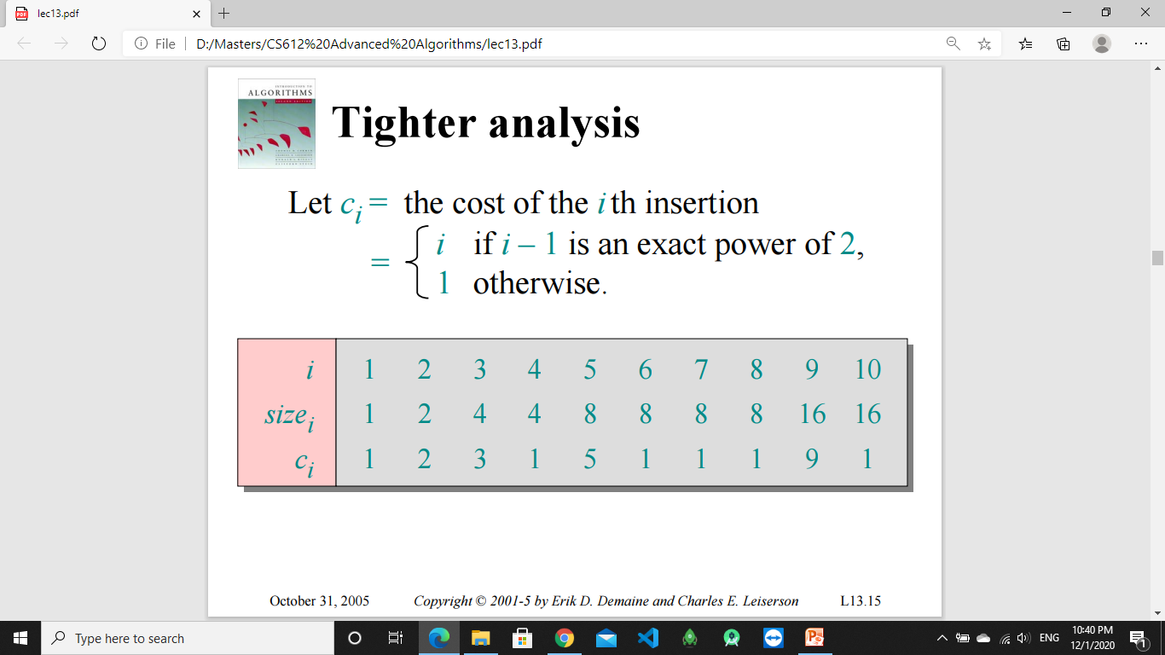

Slide 21
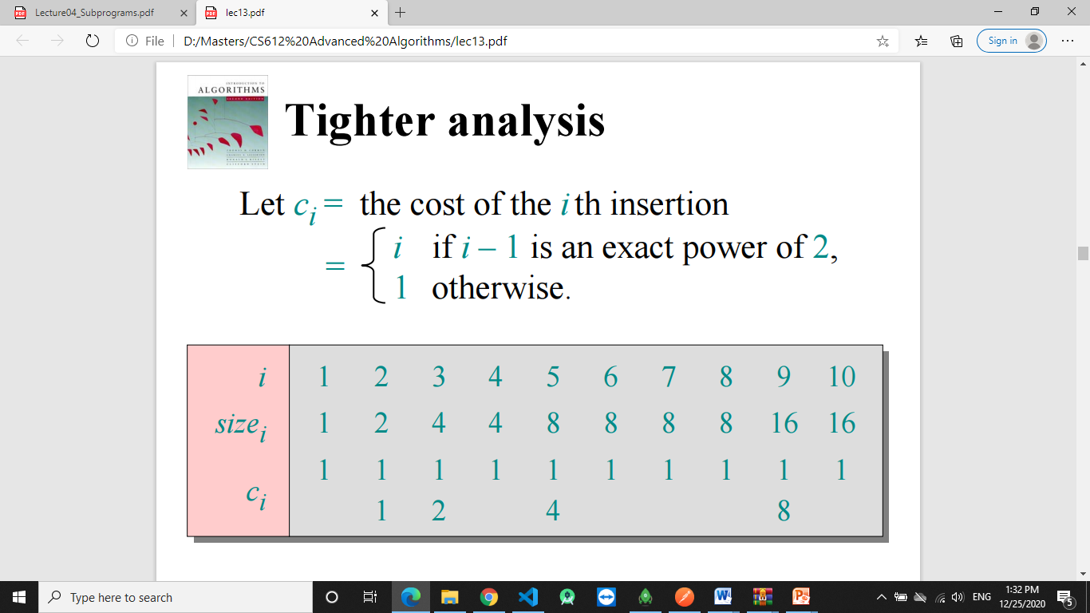

Slide 22
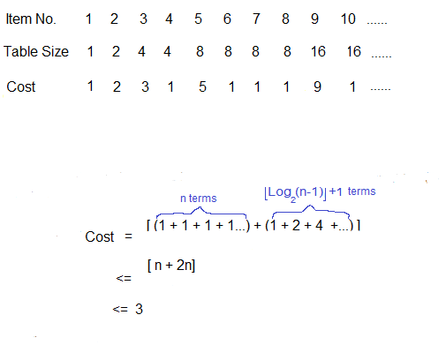
Geometric series
O(3n) = O(n)
Cost on n insertions is O(n)

Slide 23
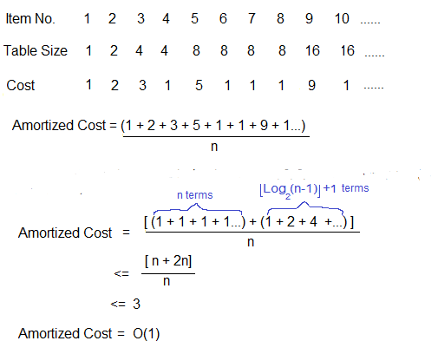

Slide 24
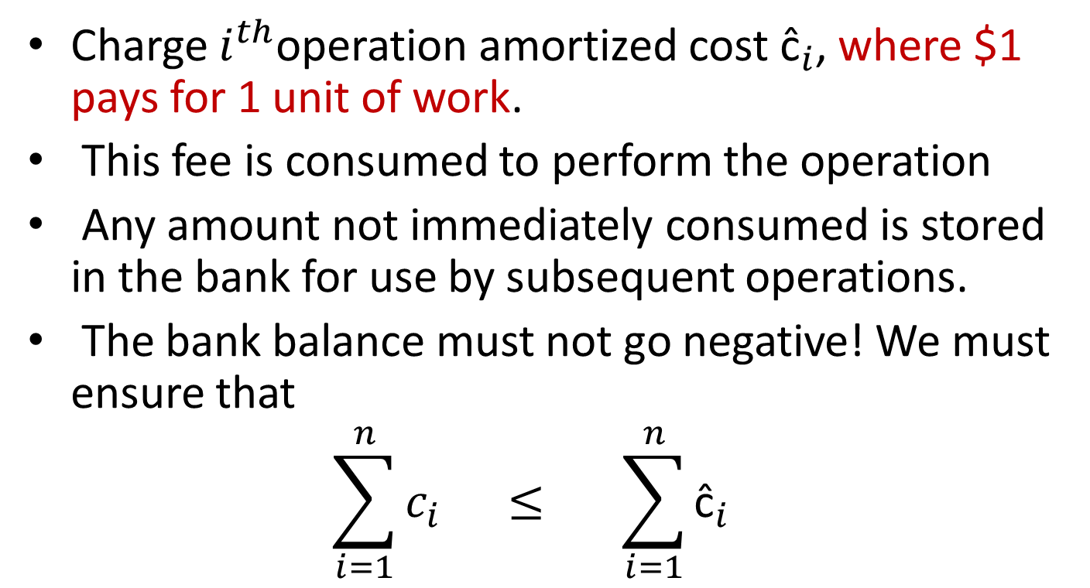
Accounting Method
Charge $i^{th}$operation amortized cost ${\text{ĉ}}_{i}$, where $1 pays for 1 unit of work.
This fee is consumed to perform the operation
Any amount not immediately consumed is stored in the bank for use by subsequent operations.
The bank balance must not go negative! We must ensure that
$$\sum_{i=1}^{n}{c_{i} ≤ \sum_{i=1}^{n}{{\text{ĉ}}_{i}} }$$

Slide 25
How much money do we need to charge at each operation, so that all future costs can be paid for?
How much money to earn for each Appended element ?
Notice that:- $1 pays for 1 unit of work
If we charge $3 upon each APPEND it is enough money to pay for all costs in the sequence of APPEND operations.

Slide 26
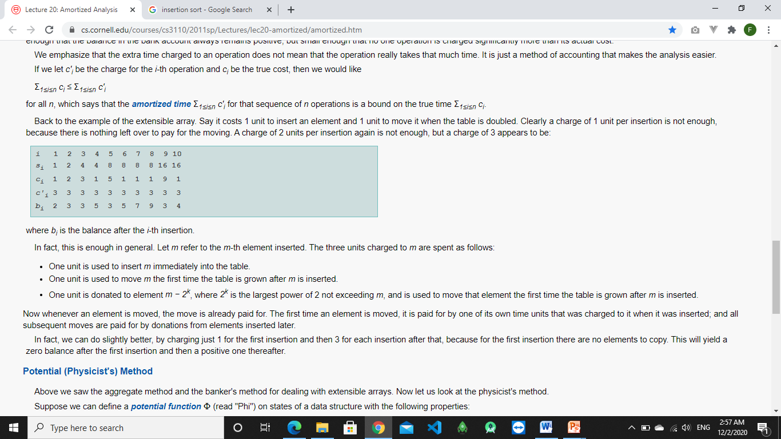
Key invariant: Bank balance never drops below 0. Thus, the sum of the amortized costs provides an upper bound on the sum of the true costs.

Slide 27
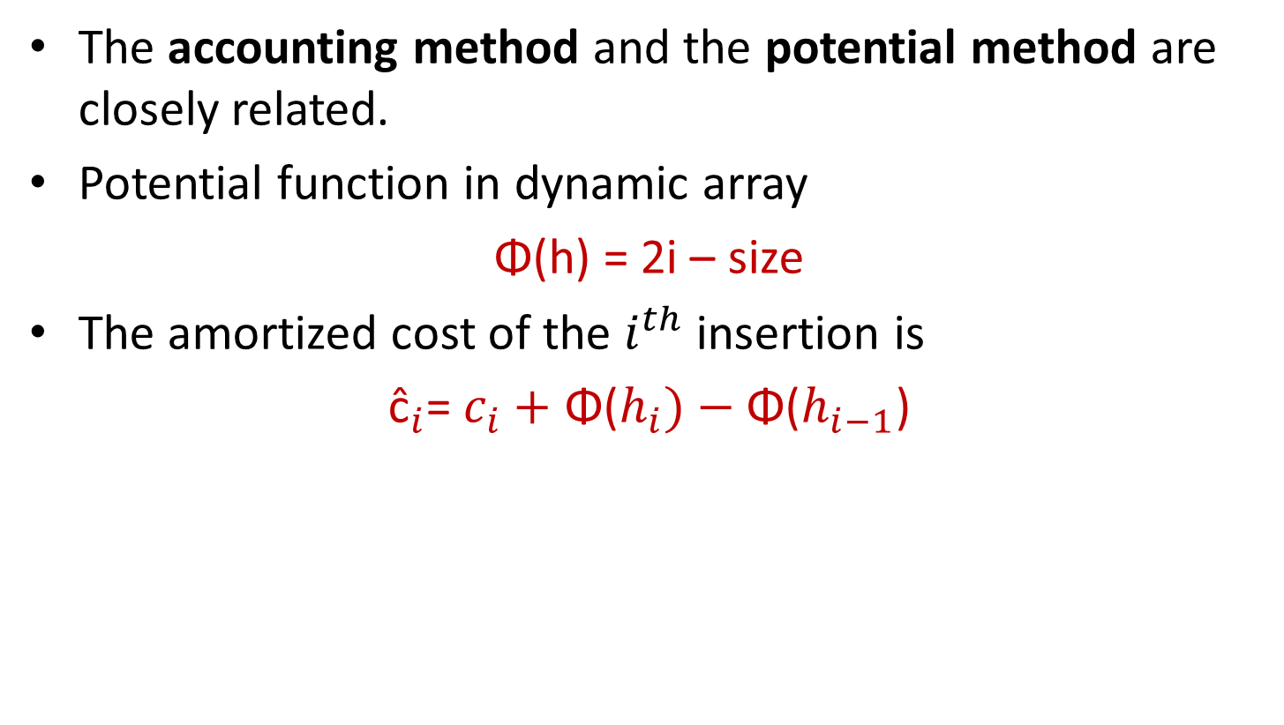
Potential Method
The accounting method and the potential method are closely related.
Potential function in dynamic array
Φ(h) = 2i – size
The amortized cost of the $i^{th}$insertion is
${\text{ĉ}}_{i}$= $c_{i}+$ Φ($h_{i})−\text{Φ}\text{(}h_{i−1}\text{)}$

Slide 28
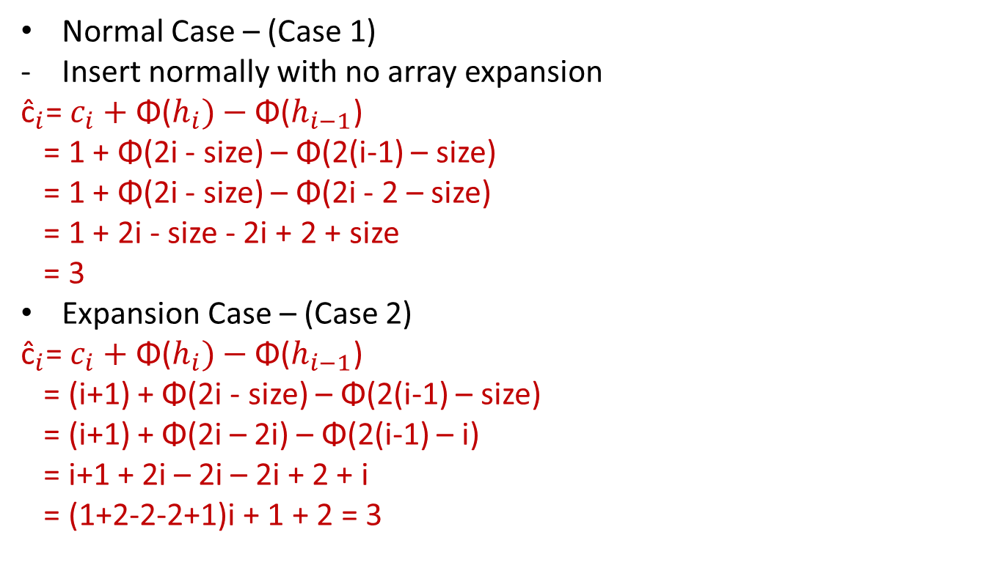
Normal Case – (Case 1)
Insert normally with no array expansion
${\text{ĉ}}_{i}$= $c_{i}+$ Φ($h_{i})−\text{Φ}\text{(}h_{i−1}\text{)}$
= 1 + Φ(2i - size) – Φ(2(i-1) – size)
= 1 + Φ(2i - size) – Φ(2i - 2 – size)
= 1 + 2i - size - 2i + 2 + size
= 3
Expansion Case – (Case 2)
${\text{ĉ}}_{i}$= $c_{i}+$ Φ($h_{i})−\text{Φ}\text{(}h_{i−1}\text{)}$
= (i+1) + Φ(2i - size) – Φ(2(i-1) – size)
= (i+1) + Φ(2i – 2i) – Φ(2(i-1) – i)
= i+1 + 2i – 2i – 2i + 2 + i
= (1+2-2-2+1)i + 1 + 2 = 3

Slide 29
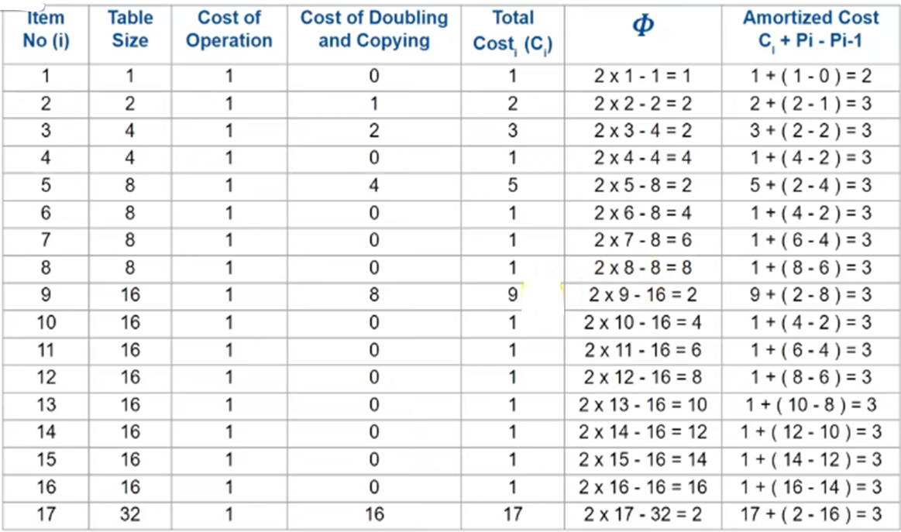

Slide 30
Contents
How Separate Chaining works
Analysis
Extended Technique
Rehashing

Slide 31
Separate Chaining (open hashing)
Assume we have hash(k1) = i = hash(k2), where k1 and k2 are the distinct keys for two data entries e1 and e2 we want to store in the table (A) of size m. The simplest way to deal with collisions is a technique called separate chaining. In this case we just arrange e1 and e2 into a chain (implemented as a linked list) and store this list in A[i].
0
e2
i
e1
m- 1

Slide 32
Separate Chaining (open hashing)
Separate Chaining (open hashing)
Advantages: 1) Simple to implement. 2) Hash table never fills up, we can always add more elements to the chain. 3) Less sensitive to the hash function or load factors. 4) It is mostly used when it is unknown how many and how frequently keys may be inserted or deleted.
Disadvantages: 1) Cache performance of chaining is not good as keys are stored using a linked list. 2) Wastage of Space (Some Parts of hash table are never used) 3) If the chain becomes long, then search time can become O(n) in the worst case. 4) Uses extra space for links.

Slide 33
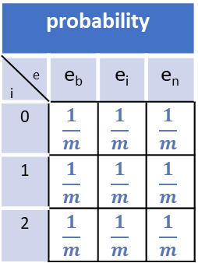



under the assumption that each key is equally likely to be hashed to any slot of table (simple uniform hashing),
How to obtain the expected length for any Chain in the hash table ?
Lets say that:
$$m =Number of slots in the table$$
$n=Number of keys to be inserted in hash table$
This is called the
Load Factor
of the hash table
$\frac{n}{m}$
$$= α$$
n = 3, m = 3
$α= \frac{3}{3}=1$
probability
_{e} _{i} | e_{b} | e_{i} | e_{n}
0 | $$\frac{1}{m}$$ | $$\frac{1}{m}$$ | $$\frac{1}{m}$$
1 | $$\frac{1}{m}$$ | $$\frac{1}{m}$$ | $$\frac{1}{m}$$
2 | $$\frac{1}{m}$$ | $$\frac{1}{m}$$ | $$\frac{1}{m}$$
n = 6, m = 3
$α= \frac{6}{3}=2$
0
e_{b}
0
e_{a}
e_{b}
1
e_{j}
1
e_{k}
e_{j}
2
e_{n}
2
e_{x}
e_{n}
Notes:
This Load Factor needs to be kept low, so that number of entries at one index is less and so is the complexity almost constant, i.e., O(1).

Slide 34


under the assumption that each key is equally likely to be hashed to any slot of table (simple uniform hashing),
Searching for e_{w}
1
Length of the chain
2
3
Hash ( key ( e_{w} ) )
= 2
$$α$$
0
e_{a}
e_{b}
e_{c}
1
e_{k}
e_{j}
e_{d}
1
2
e_{x}
e_{e}
e_{w}
Expected time to search =
$$Ο( )$$
+

Slide 35




under the assumption that each key is equally likely to be hashed to any slot of table (simple uniform hashing),
Deleting e_{w}
3
Length of the chain
Hash ( key ( e_{w} ) )
= 2
0
e_{a}
e_{b}
e_{c}
1
e_{k}
e_{j}
e_{d}
2
e_{x}
e_{e}
e_{w}
Expected time to search =
$$Ο( )$$
1
+
$$α$$
Expected time to delete =
$$Ο( )$$
$$Ο( )$$
1 + $α$ + 1
1 + $α$

Slide 36


under the assumption that each key is equally likely to be hashed to any slot of table (simple uniform hashing),
Inserting e_{w}
Hash ( key ( e_{w} ) )
= 2
0
e_{a}
e_{b}
e_{c}
1
e_{k}
e_{j}
e_{d}
2
e_{x}
e_{e}
e_{w}
Expected time to search =
$$Ο( )$$
1
+
$$α$$
Expected time to delete =
$$Ο( )$$
$$Ο( )$$
In general, as long as we don’t let the load factor become too large, the average time should be O(1).
1 + $α$ + 1
1 + $α$
Expected time to insert =
$$Ο( )$$
$$Ο( )$$
1 + 1
1

Slide 37
worst case:
When all n elements stored in one chain.
chain length = n
Expected time to search = O(1 + n) → O( n)
Expected time to delete = O(1 + n) → O( n)
0
i
e1
e2
e3
........
e_{n-1}
e_{n}
m - 1
Worst case example

Slide 38
limitations of the separate chaining.
The deletion & searching take O (n) time in worst case.
When the data is inserted in the unsorted order that needs more time to search for an element rather when data is sorted.
On the basic of above two limitations of separate chaining, we need better data structure for resolve collision.
Extended technique:
proposed that each index of hash table contains binary search tree (BST) instead of linked list. We know that the BST is extended as the data grows.
0 | 1 | 2 | 3 | 4 | 5 | …….. | m - 1
50
55
30
80
35
85
10
40
45

Slide 39
Analysis
Worst case
When all the keys are collides and hashed at the same index. (Total elements = n)
Case 1: (Elements comes in Sorted Order)
Where all the keys come in the sorted order then the tree expands either on left side (when keys in descending order) or on right
side (when keys come in increasing order). Then the complexity will be:
O (n)
Case 2: (Elements comes in Unsorted Order)
When all the elements not in any sorted order and height of tree is minimum. Then the complexity will be:
O (log n)
0 | 1 | 2 | 3 | 4 | 5 | …….. | m - 1
50
30
80
10
40

Slide 40
Analysis
Worst case
When all the keys are collides and hashed at the same index. (Total elements = n)
Case 1: (Elements comes in Sorted Order)
Where all the keys come in the sorted order then the tree expands either on left side (when keys in descending order) or on right
side (when keys come in increasing order). Then the complexity will be:
O (n)
Case 2: (Elements comes in Unsorted Order)
When all the elements not in any sorted order and height of tree is minimum. Then the complexity will be:
O (log n)
0 | 1 | 2 | 3 | 4 | 5 | …….. | m - 1
e_{n}
….
40
30
20
10
n elements

Slide 41
Analysis
Worst case
When all the keys are collides and hashed at the same index. (Total elements = n)
Case 1: (Elements comes in Sorted Order)
Where all the keys come in the sorted order then the tree expands either on left side (when keys in descending order) or on right
side (when keys come in increasing order). Then the complexity will be:
O (n)
Case 2: (Elements comes in Unsorted Order)
When all the elements not in any sorted order and height of tree is minimum. Then the complexity will be:
O (log n)
0 | 1 | 2 | 3 | 4 | 5 | …….. | m - 1
e_{n}
….
40
10
30
50
n elements

Slide 42
Analysis
Best case
When all keys are equally distributed over all the slots or indexes of hash table. Means each BST contains same elements. Most likely then:
Case 1: (Worst case of BST)
Where all the keys come in the sorted order, then the complexity will be :
O (n/m) or O (n/Table size)
Case 2: When all the keys not in any sorted order and height of tree is minimum. Then the complexity will be:
O (log (n/m)) or O (log (n/Table size))
0 | 1 | …….. | m - 1
e1
e3
e6
e2
e5
e7
e4
en
e8
Expected height of the skewed tree

Slide 43
Analysis
Best case
When all keys are equally distributed over all the slots or indexes of hash table. Means each BST contains same elements. Most likely then:
Case 1: (Worst case of BST)
Where all the keys come in the sorted order, then the complexity will be :
O (n/m) or O (n/Table size)
Case 2: When all the keys not in any sorted order and height of tree is minimum. Then the complexity will be:
O (log (n/m)) or O (log (n/Table size))
Expected height of the skewed tree
0 | 1 | …….. | m - 1
e1
e6
e11
e2
e5
e7
e8
e13
e12
e3
e4
e10
e9
en
e14
Expected number of nodes in the tree

Slide 44

Analysis
by the analysis of separate chaining with BST we knew that the complexities of all the operations of hashing is going to be better except case1 of the worst case (the skewed tree ).
We can fix this by using the AVL tree
AVL tree is a self-balancing Binary Search Tree (BST) where the difference between heights of left and right subtrees cannot be more than one for all nodes.
$\left|2−3\right|$ = 1
3
2
1
0
2
3
40
BalanceFactor = height(left-sutree) − height(right-sutree)
40
20
60
10
30
50
70
80

Slide 45

Analysis
by the analysis of separate chaining with BST we knew that the complexities of all the operations of hashing is going to be better except case1 of the worst case (the skewed tree ).
We can fix this by using the AVL tree
AVL tree is a self-balancing Binary Search Tree (BST) where the difference between heights of left and right subtrees cannot be more than one for all nodes.
3
2
1
0
BalanceFactor = height(left-sutree) − height(right-sutree)
40
20
60
10
30
50
70
70
0
80
1
$\left|0−1\right|$ = 1

Slide 46
Analysis
by the analysis of separate chaining with BST we knew that the complexities of all the operations of hashing is going to be better except case1 of the worst case (the skewed tree ).
We can fix this by using the AVL tree
AVL tree is a self-balancing Binary Search Tree (BST) where the difference between heights of left and right subtrees cannot be more than one for all nodes.
0 | 1 | 2 | 3 | 4 | 5 | …….. | m - 1
insert
20
So for the AVL tree all the operation complexity is O (log n), where n is the number of element.
40
Unbalanced Tree
30
Balanced Tree

Slide 47



Rehashing
As we mentioned, in general, as long as we don’t let the load factor become too large, the average time should be O(1).
threshold value = 2
In separate chaining the load factor can rise above 1 without hurting performance very much. in other types, once the load factor elements reaches or crosses 0.75 or 0.5 the complexity increases.
insert
11
22
So to overcome this the size of the array is increased by double and all the values are hashed again and stored in the new array of a larger size with a new hash function.
0
12
This is the Rehashing
1
10
7
2
14
5
Steps for Rehashing as follows:
For every new entry into the map, check the load factor.
If the load factor is greater than its threshold value, then start Rehash.
For Rehashing, initialize a new array with larger size.
Copy all elements into a new array and make it the new bucket array.
11
7
6
5
$loadfactor= \frac{5}{ 3 } =$
$loadfactor= \frac{5}{ 3 } =$
$loadfactor= \frac{5}{ 3 } =$
2.33
2
1.67
> threshold ?
start rehashing

Slide 48

Rehashing
As we mentioned, in general, as long as we don’t let the load factor become too large, the average time should be O(1).
threshold value = 2
In separate chaining the load factor can rise above 1 without hurting performance very much. in other types, once the load factor elements reaches or crosses 0.75 or 0.5 the complexity increases.
insert
11
22
So to overcome this the size of the array is increased by double and all the values are hashed again and stored in the new array of a larger size with a new hash function.
0
12
This is the Rehashing
1
7
2
14
Steps for Rehashing as follows:
For every new entry into the map, check the load factor.
If the load factor is greater than its threshold value, then start Rehash.
For Rehashing, initialize a new array with larger size.
Copy all elements into a new array and make it the new bucket array.
3
4
10
22
5
11
5
7
$loadfactor= \frac{5}{ 6 } =$
1.67
> threshold ?

Slide 49
Collision Resolution Technique
Open Addressing Techniques

Slide 50
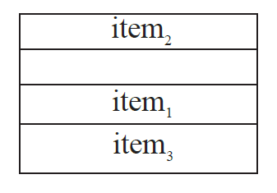
Open Addressing (Closed Hashing)
Like Separate Chaining, open addressing is a method for handling collisions.
In Open Addressing, no chaining (no pointers)
instead all items stored in the hash table itself.
One item per slot so at any point,
size of table ≥ No of keys(items).

Slide 51
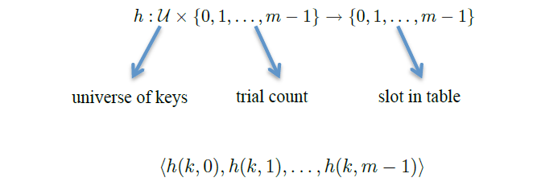
Open Addressing
Probing
With this method a hash collision is resolved by probing, or searching through alternate locations in the array (the probe sequence) until reach the target Hash function specifies order of slots to probe (examine) for a key .We want to design a function h, with the property that for all k 𝜖 U:
So the hash function depends on both the key and probe number:
The probe sequence 〈h(k,0), h(k,1), …, h(k, m–1)〉 should be a permutation of
{0, 1, …, m–1}.

Slide 52
Operations in Open Addressing
1. Insert Operation
Hash function is used to compute the hash value for a key to be inserted. Hash value is then used as an index to store the key in the hash table. Keep probing until an empty slot is found. Once an empty slot is found, insert k.
HASH-INSERT(T, k)
1 i = 0
2 repeat
3 j = h (k, i)
4 if T [j] == NIL
5 T [j] = k
6 return j
7 else i = i + 1
8 until i == m
9 error “Hash Table Overﬂow”

Slide 53
Operations in Open Addressing
2. Search Operation
Its hash value is obtained using the hash function used. Using the hash value, that bucket of the hash table is checked. Keep probing until slot’s key ≠ k or an empty slot is reached.
HASH-SEARCH(T, k)
1 i = 0
2 repeat
3 j = h (k, i)
4 if T [j] == k
5 return j
6 i = i + 1
7 until T [j] == NIL or i == m
8 return NIL

Slide 54
Operations in Open Addressing
3. Delete Operation
The key is first searched and then deleted.
Delete operation is interesting; If we simply delete a key, then the search may fail.
So slots of deleted keys are marked specially as “deleted”.
Note that:
the insert can insert an item in a deleted slot
the search doesn’t stop at a deleted slot

Slide 55
Open Addressing Techniques
A hash collision is resolved by probing with:
Linear Probing
Quadratic Probing
Double Hashing

Slide 56
Linear Probing
In linear probing:
When collision occurs, we linearly probe for the next bucket.
We keep probing until an empty bucket is found.
h(k,i) = (h′(k) + f(i) ) mod m
Ordinary hash function
Iteration sequence
Table Size
i.e. f is a linear function of i, typically f(i)= i

Slide 57
Linear Probing
let hash(x) be the slot index computed using a hash function and M be the table size
If slot hash(x) % M is full, then we try (hash(x) + 1) % M
If (hash(x) + 1) % M is also full, then we try (hash(x) + 2) % M
If (hash(x) + 2) % Mis also full, then we try (hash(x) + 3) % M
And so on …………………………………
Probe sequence:
0th probe = h(k) mod m
1th probe = (h(k) + 1) mod m
2th probe = (h(k) + 2) mod m
. . .
i^{th} probe = (h(k) + i) mod m

Slide 58
Linear Probing
EX : Let us consider a simple hash function as
“key mod 11” and sequence of keys as (7,36,18,62).
Insert (7):
h0(7) = ((7+0)mod 11) = 7
Insert (36):
h0(36) = ((36+0)mod 11) = 3
 | 0
 | 1
 | 2
36 | 3
 | 4
 | 5
 | 6
7 | 7
 | 8
 | 9
 | 10
h0(36)
Insertion
h0(7)
Insertion
Empty
Occupied
Deleted

Slide 59
Linear Probing
EX: Let us consider a simple hash function as
“key mod 11” and sequence of keys as (7,36,18,62)
Insert (18):
h0(18) = ((18+0)mod 11) = 7
h1(18) = ((18+1)mod 11) = 8
 | 0
 | 1
 | 2
36 | 3
 | 4
 | 5
 | 6
7 | 7
18 | 8
 | 9
 | 10
h0(18)
h1(18)
Collision
Insertion
Empty
Occupied
Deleted

Slide 60
Linear Probing
EX: Let us consider a simple hash function as
“key mod 11” and sequence of keys as (7,36,18,62)
Insert (62):
h0(62) = (62+0)mod 11) = 7
h1(62) = ((62+1)mod 11) = 8
h2(62) = ((62+2)mod 11) = 9
 | 0
 | 1
 | 2
36 | 3
 | 4
 | 5
 | 6
7 | 7
18 | 8
62 | 9
 | 10
h0(62)
h1(62)
Collision
h2(62)
Collision
Empty
Occupied
Deleted
Insertion

Slide 61
Linear Probing
EX: Let us consider a simple hash function as
“key mod 11” and sequence of keys as (7,36,18,62).
Search (18):
h0(18) = ((18+0)mod 11) = 7 not matching
h1(18) = ((18+1)mod 11) = 8 matched or found
 | 0
 | 1
 | 2
36 | 3
 | 4
 | 5
 | 6
7 | 7
18 | 8
 | 9
 | 10
h0(18)
h1(18)
≠Key
Matched
Empty
Occupied
Deleted

Slide 62
Linear Probing
EX : Let us consider a simple hash function as
“key mod 11” and sequence of keys as (7,36,18,62).
Delete (18) search (62) fail
Search (62):
h0(62) = ((62+0)mod 11) = 7 not matching
h1(62) = ((62+1)mod 11) = 8
Empty mean it will break the search
 | 0
 | 1
 | 2
36 | 3
 | 4
 | 5
 | 6
7 | 7
 | 8
62 | 9
 | 10
h1(62)
Not found
Empty
Occupied
Deleted

Slide 63
Linear Probing
EX : Let us consider a simple hash function as
“key mod 11” and sequence of keys as (7,36,18,62).
Delete (18) search (62) found
h2(62) = ((62+2)mod 11) = 9
replace item with special flag “Deleted”
which Insert treats as None but Search doesn't
 | 0
 | 1
 | 2
36 | 3
 | 4
 | 5
 | 6
7 | 7
 | 8
62 | 9
 | 10
h2(62)
Empty
Occupied
Deleted
Found

Slide 64
Linear Probing
EX : Let us consider a simple hash function as
“key mod 11” and sequence of keys as (7,36,18,62).
Insert (51):
h0(51) = ((51+0)mod 11) = 7
h1(51) = ((51+1)mod 11) = 8
 | 0
 | 1
 | 2
36 | 3
 | 4
 | 5
 | 6
7 | 7
51 | 8
62 | 9
 | 10
h0(51)
h1(51)
Collision
Insertion
Empty
Occupied
Deleted

Slide 65
Linear Probing
Time Complexity
Worst time to search an element in linear probing is O (table size).
This is because:
Even if there is only one element present and all other elements are deleted.
Then, “deleted” markers present in the hash table makes search the entire table.

Slide 66
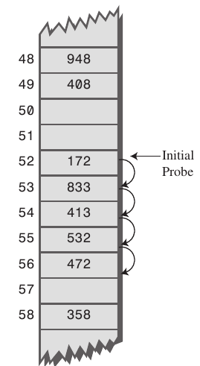
Linear Probing
Advantage:
It is easy to compute.
Best cache performance.
We have solve the issue of extra memory
and utilize the available memory in the hash table
Disadvantage:
Primary Clustering:
The main problem with linear probing is clustering.
Many consecutive elements form groups.
Then, it takes time to search an element or to find an empty bucket.
As long as table is big enough, a free cell can always be found,
but the time to do so can get quite large

Slide 67
Quadratic Probing
In quadratic probing:
When collision occurs, we probe for 𝑖^2 th bucket in 𝑖^𝑡ℎ iteration.
We keep probing until an empty bucket is found.
h(k,i) = (h′(k) + f(i) ) mod m
Ordinary hash function
Iteration sequence
Table Size
i.e. f is a linear function of i, typically f(i)= 𝑖^2

Slide 68
Quadratic Probing
let hash(x) be the slot index computed using a hash function and M be the table size
If slot hash(x) % M is full, then we try (hash(x) + 1*1) % M
If (hash(x) + 1*1) % M is also full, then we try (hash(x) + 2*2) % M
If (hash(x) + 2*2) % Mis also full, then we try (hash(x) + 3*3) % M
And so on …………………………………
Probe sequence:
0th probe = h(k) mod m
1th probe = (h(k) + 1*1) mod m
2th probe = (h(k) + 2*2) mod m
. . .
i^{th} probe = (h(k) +i* i) mod m

Slide 69
Quadratic Probing
EX : Let us consider a simple hash function as
“key mod 11” and sequence of keys as (7,36,18,62).
Insert (7):
h0(7) = ((7+0*0)mod 11) = 7
Insert (36):
h0(36) = ((36+0*0)mod 11) = 3
 | 0
 | 1
 | 2
36 | 3
 | 4
 | 5
 | 6
7 | 7
 | 8
 | 9
 | 10
h0(36)
Insertion
h0(7)
Insertion
Empty
Occupied
Deleted

Slide 70
Quadratic Probing
EX : Let us consider a simple hash function as
“key mod 11” and sequence of keys as (7,36,18,62).
Insert (18):
h0(18) = ((18+0*0)mod 11) = 7
h1(18) = ((18+1*1)mod 11) = 8
 | 0
 | 1
 | 2
36 | 3
 | 4
 | 5
 | 6
7 | 7
18 | 8
 | 9
 | 10
h0(18)
h1(18)
Collision
Insertion
Empty
Occupied
Deleted

Slide 71
Quadratic Probing
EX : Let us consider a simple hash function as
“key mod 11” and sequence of keys as (7,36,18,62).
Insert (62):
h0(62) = (62+0*0)mod 11) = 7
h1(62) = ((62+1*1)mod 11) = 8
h2(62) = ((62+2*2)mod 11) = 0
h2(62)
62 | 0
 | 1
 | 2
36 | 3
 | 4
 | 5
 | 6
7 | 7
18 | 8
 | 9
 | 10
Insertion
h0(62)
h1(62)
Collision
Collision
Empty
Occupied
Deleted

Slide 72
Quadratic Probing
EX : Let us consider a simple hash function as
“key mod 11” and sequence of keys as (7,36,18,62).
Insert (51):
h0(51) = (51+0*0)mod 11) = 7
h1(51) = ((51+1*1)mod 11) = 8
h2(51) = ((51+2*2)mod 11) = 0
h3(51) = ((51+3*3)mod 11) = 5
h2(51)
62 | 0
 | 1
 | 2
36 | 3
 | 4
51 | 5
 | 6
7 | 7
18 | 8
 | 9
 | 10
Collision
h3(51)
Insertion
h0(51)
h1(51)
Collision
Collision
Empty
Occupied
Deleted

Slide 73
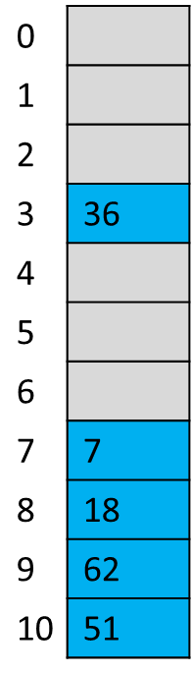
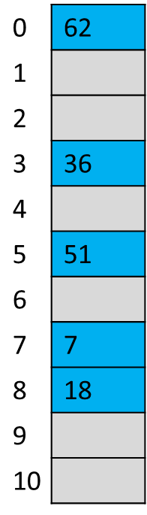
Linear Probing vs Quadratic Probing
Linear Probing
Insert (7,36,18,62,51)
Quadratic Probing
Insert (7,36,18,62,51)

Slide 74
Quadratic Probing
Advantage:
Average cache performance
Suffer a lesser clustering that linear probing
Disadvantage:
If two keys have the same initial probe position, then their probe sequences are the same, since h(k1, 0) = h(k2, 0) implies h(k1, i) = h(k2, i). This property leads to a milder form of clustering, called secondary clustering
Unable to add an element in Quadratic Probing because the index calculated is never empty

Slide 75
Quadratic Probing
Secondary Clustering example: Let us consider a simple hash function as “key mod 10” and sequence of keys as (2,12,22,32,42,52).
Insert (2):
h0(2) = ((2+0*0)mod 10) = 2
Insert (12):
h0(12) = ((12+0*0)mod 10) = 2
h1(12) = ((12+1*1)mod 10) = 3
 | 0
 | 1
2 | 2
12 | 3
 | 4
 | 5
 | 6
 | 7
 | 8
 | 9
h0(2)
Insertion
h1(12)
Insertion
Occupied
Empty
Occupied
Deleted

Slide 76
Quadratic Probing
Secondary Clustering example: Let us consider a simple hash function as “key mod 10” and sequence of keys as (2,12,22,32,42,52).
Insert (22):
h0(22) = ((22+0*0)mod 10) = 2
h1(22) = ((22+1*1)mod 10) = 3
h2(22) = ((22+2*2)mod 10) = 6
And so on
 | 0
 | 1
2 | 2
12 | 3
 | 4
 | 5
22 | 6
 | 7
 | 8
 | 9
h0(22)
Collision
h1(22)
Collision
h2(22)
Insertion
Empty
Occupied
Deleted

Slide 77
Quadratic Probing
Secondary Clustering example: Let us consider a simple hash function as “key mod 10” and sequence of keys as (2,12,22,32,42,52).
Insert (32):
h3(32) = ((32+3*3)mod 10) = 1
Insert (42):
h4(42) = ((32+4*4)mod 10) = 8
Insert (52):
h5(52) = ((52+5*5)mod 10) = 7
 | 0
32 | 1
2 | 2
12 | 3
 | 4
 | 5
22 | 6
52 | 7
42 | 8
 | 9
h3(32)
h5(52)
Empty
Occupied
Deleted
h4(42)

Slide 78
Quadratic Probing
Secondary Clustering example: Let us consider a simple hash function as “key mod 10” and sequence of keys as (2,12,22,32,42,52).
Insert (62):
h6(62) = ((62+6*6)mod 10) = 8
h7(62) = ((62+7*7)mod 10) = 1
h8(62) = ((62+8*8)mod 10) = 6
h9(62) = ((62+9*9)mod 10) = 3
Unable to insert an element
 | 0
32 | 1
2 | 2
12 | 3
 | 4
 | 5
22 | 6
52 | 7
42 | 8
 | 9
Empty
Occupied
Deleted

Slide 79
Quadratic Probing
So it’s preferred that
Table should be at most half full
table size must be prime
otherwise insertion may fail (always have a collision)

Slide 80
Double Hashing
In double hashing:
We use another hash function hash2(x) and look for i*hash2(x) slot in i’th rotation.
It requires more computation time as two hash functions need to be computed.
h(k,i) = (h′(k) + f(i) ) mod m
Ordinary hash function
Iteration sequence
Table Size
i.e. f is a linear function of i, typically f(i)= i*hash2(k)

Slide 81
Double Hashing
let hash(x) be the slot index computed using a hash function and M be the table size
If slot hash(x) % M is full, then we try (hash(x) + 1*hash2(x)) % M
If (hash(x) + 1*hash2(x)) % M is also full, then we try (hash(x) + 2*hash2(x)) % M
If (hash(x) + 2*hash2(x)) % Mis also full, then we try (hash(x) + 3*hash2(x)) % M
And so on …………………………………
(We repeat by increasing i when collision occurs)
Probe sequence:
0th probe = hash1(k) mod m
1th probe = (hash1(k) + 1*hash2(k)) mod m
2th probe = (hash1(k) + 2*hash2(k)) mod m
. . .
i^{th} probe = (hash1(k) + i*hash2(k)) mod m

Slide 82
Double Hashing
Double hashing uses the idea of applying a second hash function to key when a collision occurs.
First hash function is typically hash1(key) = key % TABLE_SIZE
A popular second hash function is : hash2(key) = PRIME – (key % PRIME) where PRIME is a prime smaller than the TABLE_SIZE.
A good second Hash function is:
It must never evaluate to zero.
Must make sure that all cells can be probed.

Slide 83
Double Hashing
Ex : Let us consider a simple hash function hash1 as “key mod 10” and sequence of keys as (37,90,45,22,17,49,55).
Let hash2(k)=7-(key % mod 7)
Insert (37):
hi(key)=(hash1(key)+i*(hash2(key)) mod table_size
h0(37)=((37 % 10)+0*(7-(37%7))) mod 10 = 7
Insert (90):
h0(90)=((90 % 10)+0*(7-(90%7))) mod 10 = 0
h0(90)
90 | 0
 | 1
 | 2
 | 3
 | 4
 | 5
 | 6
37 | 7
 | 8
 | 9
Insertion
h0(37)
Insertion
Empty
Occupied
Deleted

Slide 84
Double Hashing
Ex : Let us consider a simple hash function hash1 as “key mod 10” and sequence of keys as (37,90,45,22,17,49,55).
Let hash2(k)=7-(key % mod 7)
Insert (45):
h0(45)=((45 % 10)+0*(7-(45%7))) mod 10 = 5
Insert (22):
h0(22)=((22 % 10)+0*(7-(22%7))) mod 10 = 2
h0(90)
90 | 0
 | 1
22 | 2
 | 3
 | 4
45 | 5
 | 6
37 | 7
 | 8
 | 9
Insertion
h0(22)
Insertion
h0(45)
Insertion
h0(37)
Insertion
Empty
Occupied
Deleted

Slide 85
Double Hashing
Ex : Let us consider a simple hash function hash1 as “key mod 10” and sequence of keys as (37,90,45,22,17,49,55).
Let hash2(k)=7-(key % mod 7)
Insert (17):
h0(17)=((17 % 10)+0*(7-(17%7))) mod 10 = 7
h1(17)=((17 % 10)+1*(7-(17%7))) mod 10 = 1
90 | 0
17 | 1
22 | 2
 | 3
 | 4
45 | 5
 | 6
37 | 7
 | 8
 | 9
h1(17)
Insertion
h0(17)
Collision
Empty
Occupied
Deleted

Slide 86
Double Hashing
Ex : Let us consider a simple hash function hash1 as “key mod 10” and sequence of keys as (37,90,45,22,17,49,55).
Let hash2(k)=7-(key % mod 7)
Insert (49):
h0(49)=((49 % 10)+0*(7-(49%7))) mod 10 = 9
Insert (55):
h0(55)=((55 % 10)+0*(7-(55%7))) mod 10 = 5
h1(55)=((55 % 10)+1*(7-(55%7))) mod 10 = 6
90 | 0
17 | 1
22 | 2
 | 3
 | 4
45 | 5
55 | 6
37 | 7
 | 8
49 | 9
h0(55)
Collision
h1(55)
Insertion
h0(49)
Insertion
Empty
Occupied
Deleted

Slide 87
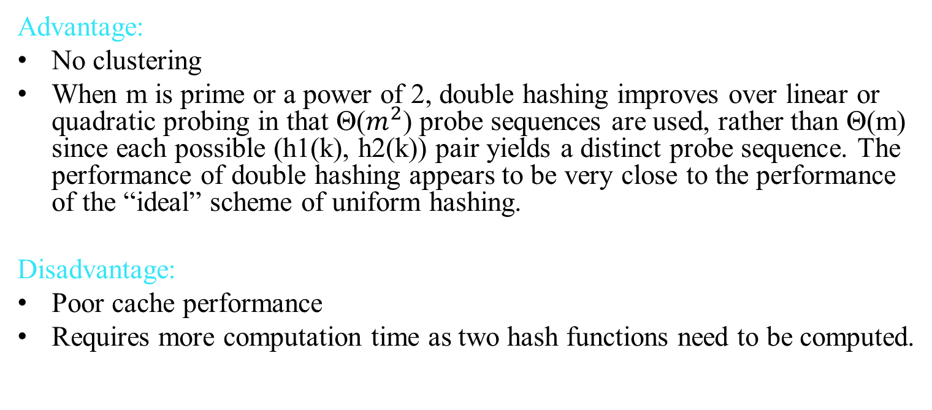
Double Hashing
Advantage:
No clustering
When m is prime or a power of 2, double hashing improves over linear or quadratic probing in that Θ($m^{2}$) probe sequences are used, rather than Θ(m) since each possible (h1(k), h2(k)) pair yields a distinct probe sequence. The performance of double hashing appears to be very close to the performance of the “ideal” scheme of uniform hashing.
Disadvantage:
Poor cache performance
Requires more computation time as two hash functions need to be computed.

Slide 88
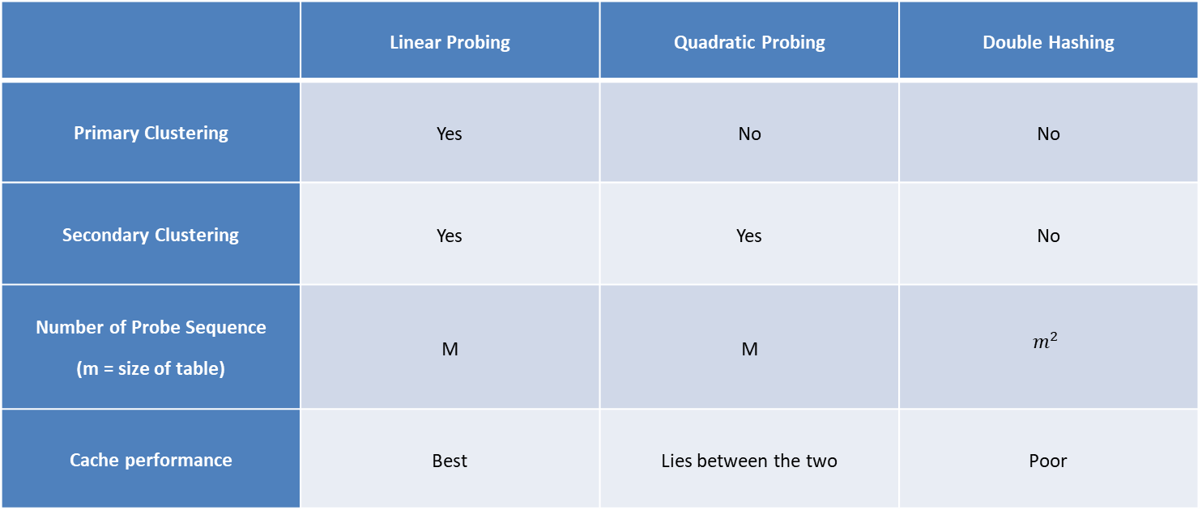
Comparison of Open Addressing Techniques
 | Linear Probing | Quadratic Probing | Double Hashing
Primary Clustering | Yes | No | No
Secondary Clustering | Yes | Yes | No
Number of Probe Sequence (m = size of table) | M | M | $$m^{2}$$
Cache performance | Best | Lies between the two | Poor

Slide 89
Analysis of open addressing
m = Number of slots in the hash table
n = Number of keys to be inserted in the hash table
Load factor $α$ = $\frac{n}{m}$ ( < 1 )
Theorem: Given an open-address hash table
with load factor α = $\frac{n}{m}$ < 1 the expected number of probes in
an unsuccessful search is at most $\frac{1}{\text{1}\text{−}\text{α}}$ assuming uniform hashing.
Corollary: Inserting an element into an open-address hash table with load factor˛ requires at most $\frac{1}{\text{1}\text{−}\text{α}}$ probes on average, assuming uniform hashing.

Slide 90
Analysis of open addressing
Implications of the theorem
If α is constant, then accessing an open-addressed hash table takes constant time.
If the table is half full, then the expected number of probes is
1/(1–0.5) = 2.
If the table is 90%full, then the expected number of probes is
1/(1–0.9) = 10.

Slide 91
Analysis of open addressing
Theorem: Given an open-address hash table with load factor α < 1, the expected number of probes in a successful search is at most $\frac{1}{\text{α}}$ ln $\frac{1}{\text{1}\text{−}\text{α}}$
assuming uniform hashing and assuming that each key in the table
is equally likely to be searched for.
If the hash table is half full, the expected number of probes in a successful search is less than 1:387.
If the hash table is 90%full, the expected number of probes is less than 2:559.

Slide 92
Rehashing
Rehashing :When the table is too full, create a new table which is the closest prime number to 2m (m the size of the old table)
How rehashing
compute the new table size
Apply it to the hash function
compute the new hash value of each element
insert it into the new table
When rehashing
half full (λ = 0.5)
when an insertion fails
when a certain load factor is reached

Slide 93
Separate Chaining Vs Open Addressing
S.NO. | SEPARATE CHAINING | OPEN ADDRESSING
1. | Chaining is Simpler to implement. | Open Addressing requires more computation.
2. | In chaining, Hash table never fills up, we can always add more elements to chain. | In open addressing, table may become full.
3. | Chaining is Less sensitive to the hash function or load factors. | Open addressing requires extra care for to avoid clustering and load factor.
4. | Chaining is mostly used when it is unknown how many and how frequently keys may be inserted or deleted. | Open addressing is used when the frequency and number of keys is known.
5. | Cache performance of chaining is not good as keys are stored using linked list. | Open addressing provides better cache performance as everything is stored in the same table.
6. | Wastage of Space (Some Parts of hash table in chaining are never used). | In Open addressing, a slot can be used even if an input doesn’t map to it.
7. | Deletion is easier. | Deletion is difficult.
8. | Chaining uses extra space for links. | No links in Open addressing

Slide 94
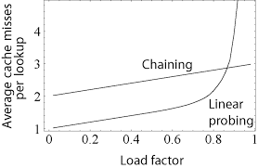
Separate Chaining Vs Open Addressing
The o(1) constant time behavior attributed to hash tables assumes the load factor ($α$) is kept below a certain fixed value. This means Once $α$ > threshold we need to grow the table Size (rehashing)

Slide 95
Separate Chaining Vs Open Addressing
• If open addressing is to be used, double hashing is preferred over quadratic probing.
• If plenty of memory is available and the data won’t expand, then linear probing is simpler to implement.
• If number of items to be inserted in hash table isn’t known, separate chaining is preferable to open addressing.
• if deletion operation is required use separate chaining
• When in doubt use separate chaining

